Slide 1
Image Encryption with 3DES
Made by Mayur Rattan Jaisinghani

Slide 2


Index
Introduction
DES
3DES
Encryption and Decryption
Algorithm
Process
Output
References
Fact:
3DES was founded in 1998 and after almost 2 decades, it has been officially retired in 2018.

Slide 3
1. Intro
In the era where everything is data driven, security is the top most priority for everyone. As a matter of fact, Apple sells its products with the promise of maximum security of user data.
We are looking at 3DES encryption of images in this project. In simple words, 3DES is application of DES algorithm to a block 3 times. There are 2 types of 3DES:
2 key version
3 key version

Slide 4
DES:
Data encryption standard (DES) is symmetric key block cipher published by the NIST.
IT is an implementation of Feistel cipher. It uses 16 round Feistel structure. The block size is 64-bit. Though, key length is 64-bit, DES has an effective key length of 56 bits, since 8 of the 64 bits of the key are not used by the encryption algorithm (function as check bits only).
Fact:
After 2023, the use of 3DES algorithm will be disallowed. After the Sweet32 vulnerability was found, NIST started talks for deprecating 3DES.

Slide 5
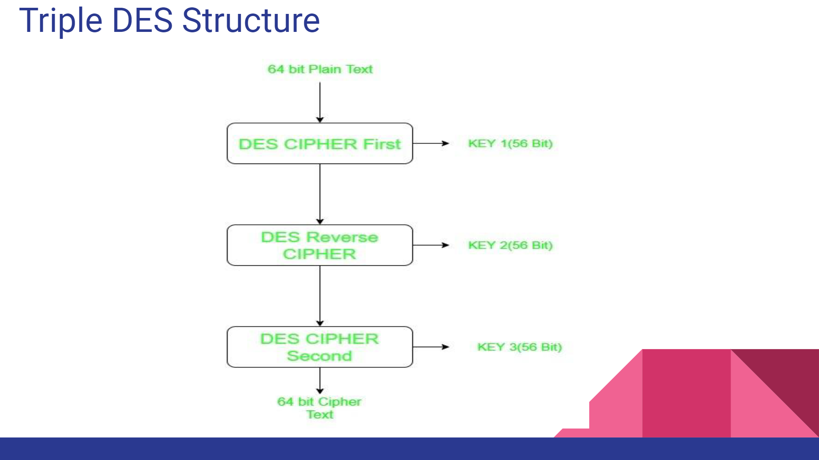
3DES:
The Triple Data Encryption Algorithm, alternately referred to as Triple DES (Data Encryption Standard), 3DES, TDES, Triple DEA, or TDEA, is a symmetric key-block cipher which applies the DES cipher in triplicate by encrypting with the first key (k1), decrypting with the second key (k2), and encrypting with the third key (k3). A two-key variant also exists, where k1 and k3 are the same.

Slide 6
Examples of 3DES
3DES is an encryption algorithm widely used in the finance industry.
3DES remains in active use in a lot of legacy systems, and also in many smart cards.

Slide 7
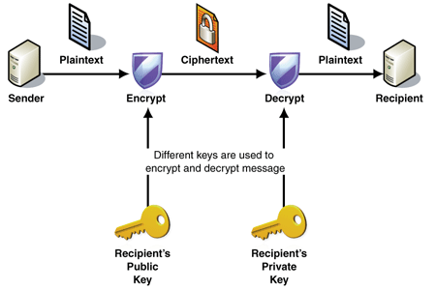
Encryption Decryption
Encryption is the process of translating plain text data (plaintext) into something that appears to be random and meaningless (ciphertext).
Decryption is the process of converting ciphertext back to plaintext.

Slide 8
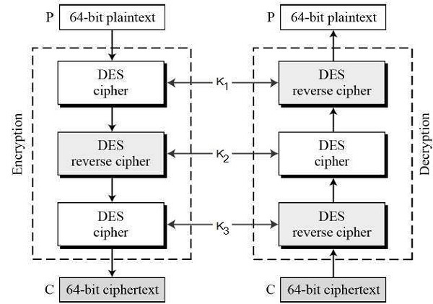
3DES Algo
Before using 3TDES, user first generate and distribute a 3TDES key K, which consists of three different DES keys K1, K2 and K3. This means that the actual 3TDES key has length 3×56 = 168 bits. The encryption scheme is illustrated as follows −
The encryption-decryption process is as follows −
Encrypt the plaintext blocks using single DES with key K1.
Now decrypt the output of step 1 using single DES with key K2.
Finally, encrypt the output of step 2 using single DES with key K3.
The output of step 3 is the ciphertext.
Decryption of a ciphertext is a reverse process. User first decrypt using K3, then encrypt with K2, and finally decrypt with K1.

Slide 9

It is not the data that is being exploited, it is the people that are being exploited.

Slide 10
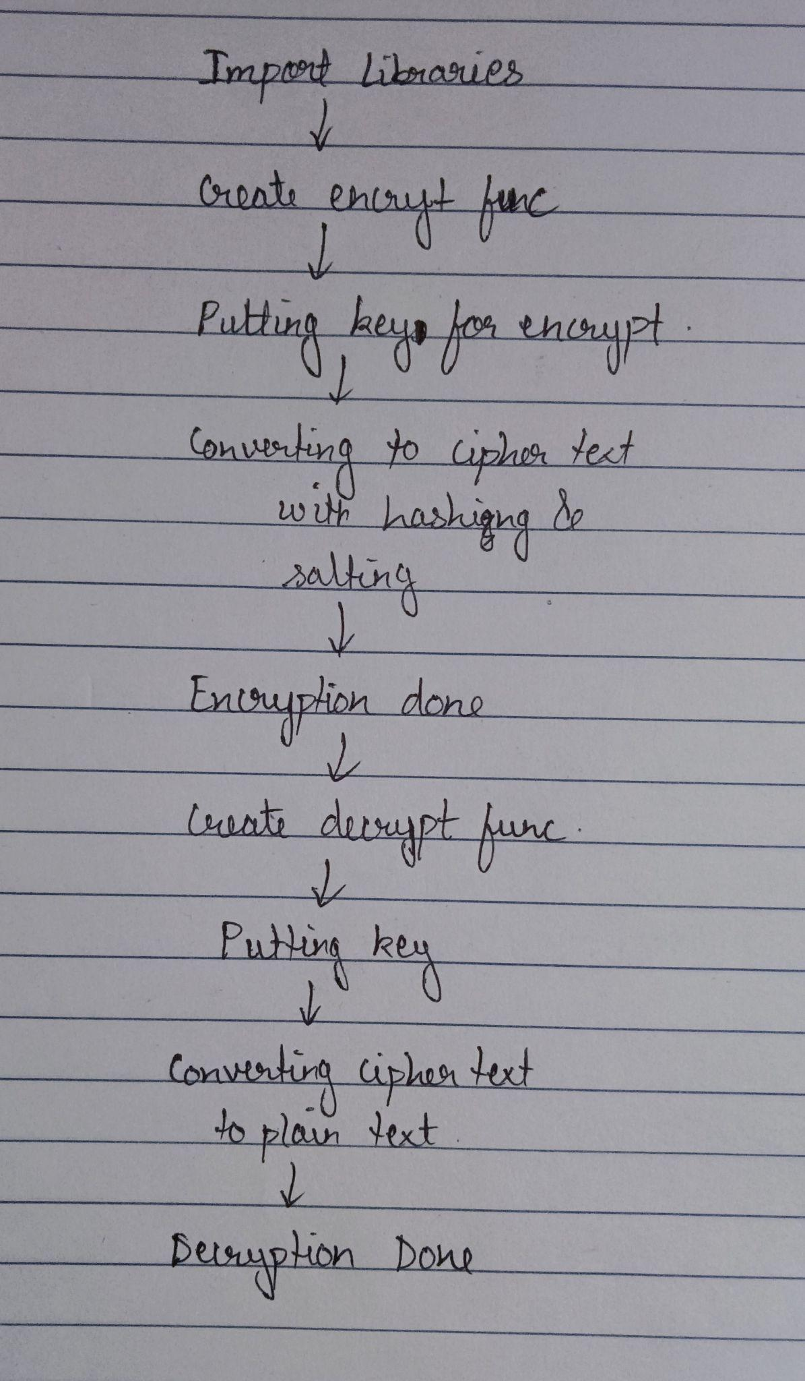
Process of 3DES image encryption:
Running of libraries
Image selection
Triple DES process
Encryption
Decryption

Slide 11

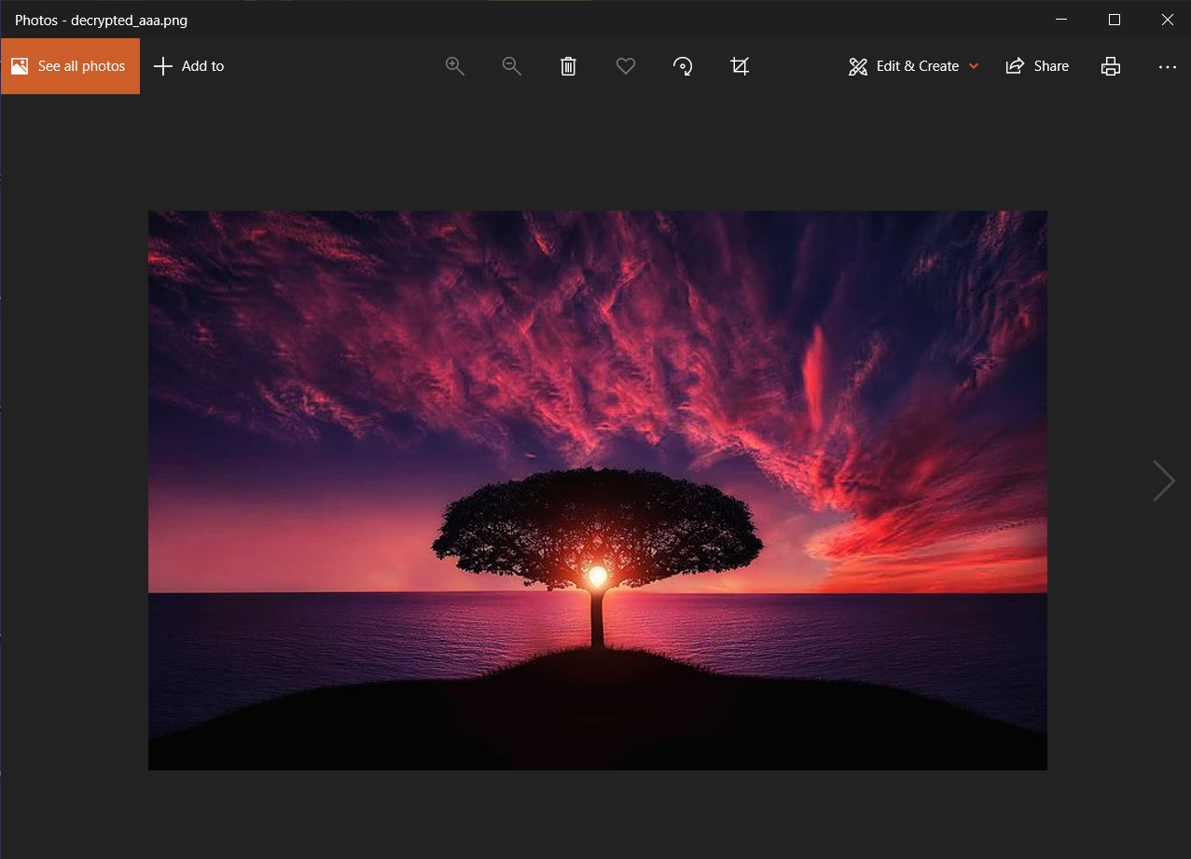
Output:
As we can see, after encryption of image, the image when opened is not visible or the image viewer shows an error.
After decryption, the image is visible again and the image viewer shows no error while opening it.

Slide 12
References:
https://github.com/divyanshukumarpcm/tripleDESanyfile/blob/main/3des.py
https://github.com/Vatshayan/Image-Security-by-Triple-DES-Final-Year-Project
https://pycryptodome.readthedocs.io/en/latest/
https://docs.microsoft.com/en-us/windows/win32/seccrypto/data-encryption-and-decryption#:~:text=Encryption%20is%20the%20process%20of,converting%20ciphertext%20back%20to%20plaintext.&text=To%20decrypt%20a%20particular%20piece,the%20data%20must%20be%20used.
https://www.tutorialspoint.com/cryptography/data_encryption_standard.htm
https://www.tutorialspoint.com/cryptography/triple_des.htm
A Review on DES, AES and Blowfish for Image Encryption & Decryption - Aarti Devi , Ankush Sharma , Anamika Rangra
Recommendation for the Triple Data Encryption Algorithm (TDEA) Block Cipher - Elaine Barker and Nicky Mouha
Data Encryption and Decryption by Using Triple DES and Performance Analysis of Crypto System - Karthik .S , Muruganandam .A
How Good Is the DES Algorithm in Image Ciphering? - Said F. El-Zoghdy, Yasser A. Nada, A. A. Abdo
Dr. Prerna Mahajan & Abhishek Sachdeva “A Study of Encryption Algorithms AES, DES and RSA for Security”.
Color Image Encryption and Decryption Using DES Algorithm Manjula K G1, M N Ravikumar2

